Slide 1
StackPointers - LianLianCan
Project Manager: Iris Fu
Scrum Master: Zilin Ma
Developers: Haipu Sun, Junjie Jiang

Slide 2
Motivation
Classical Chinese game
Childhood memory
Brain exercise ---- Important!
Pretty fun

Slide 3
What is LianLianCan? ---- Rules!
Basically a finding and matching game
There are three levels of difficulty and three different themes!
Find two identical tiles
If the number of turns from one to the other is less than 3, they can be eliminated!
Pace Up! Time is running out!
If you can’t find a match, don’t worry! There are hints!
If there is no match, don’t worry! There are shuffles!
But! If time runs out, Game Over!

Slide 4
Some challenges in our project
Algorithms to determine if two tiles can connect.

Slide 5
Key User Stories

Slide 6
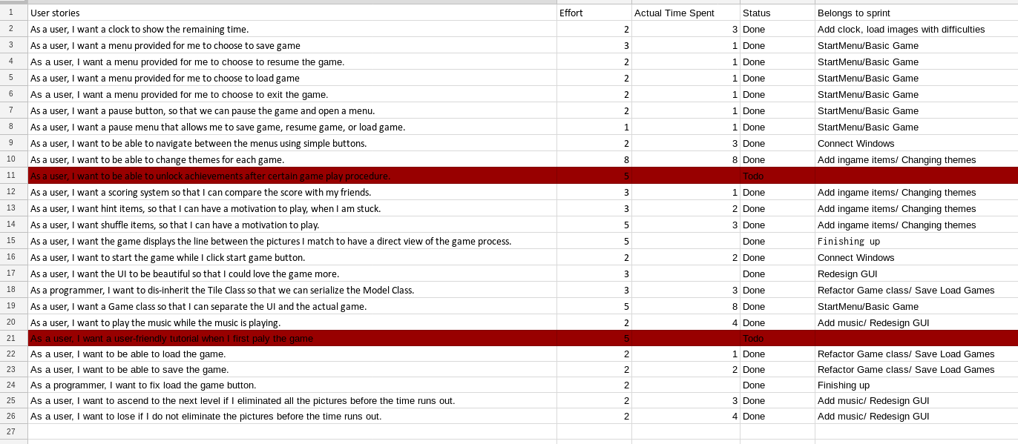
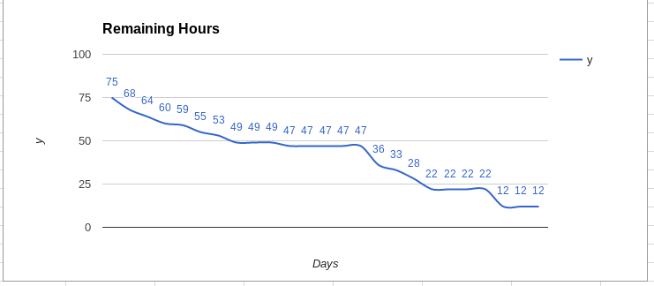
Scrum Experience

Slide 7
What will we do next time?
More detailed user stories
Find a better Scrum softwares that we can learn quickly

Slide 8
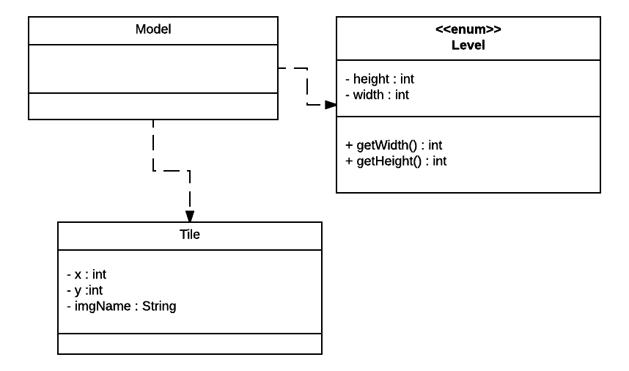
Class and UML

Slide 9
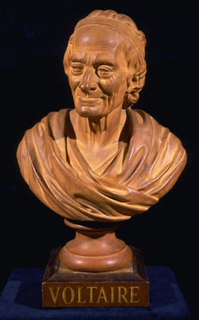

TilePane
Controller
Model

Slide 10
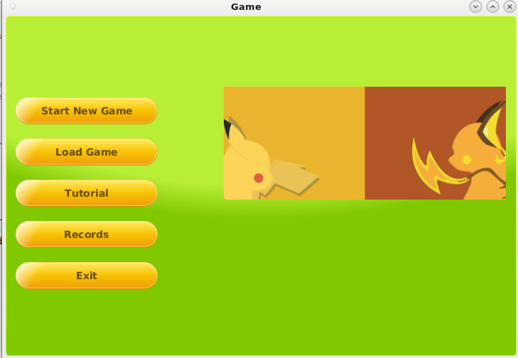
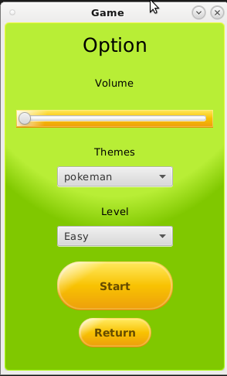
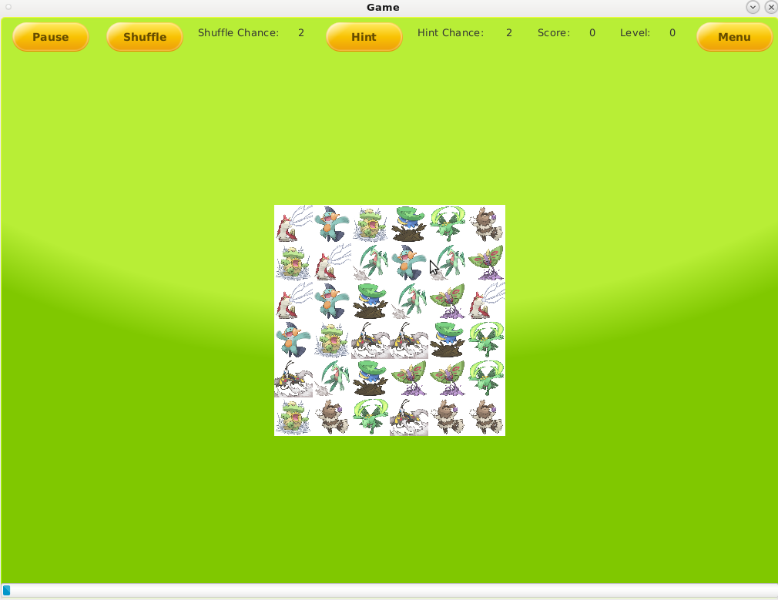
User Interface

Slide 11
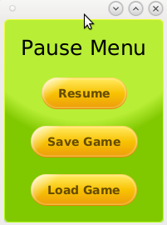
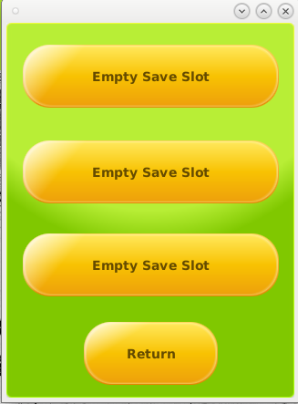
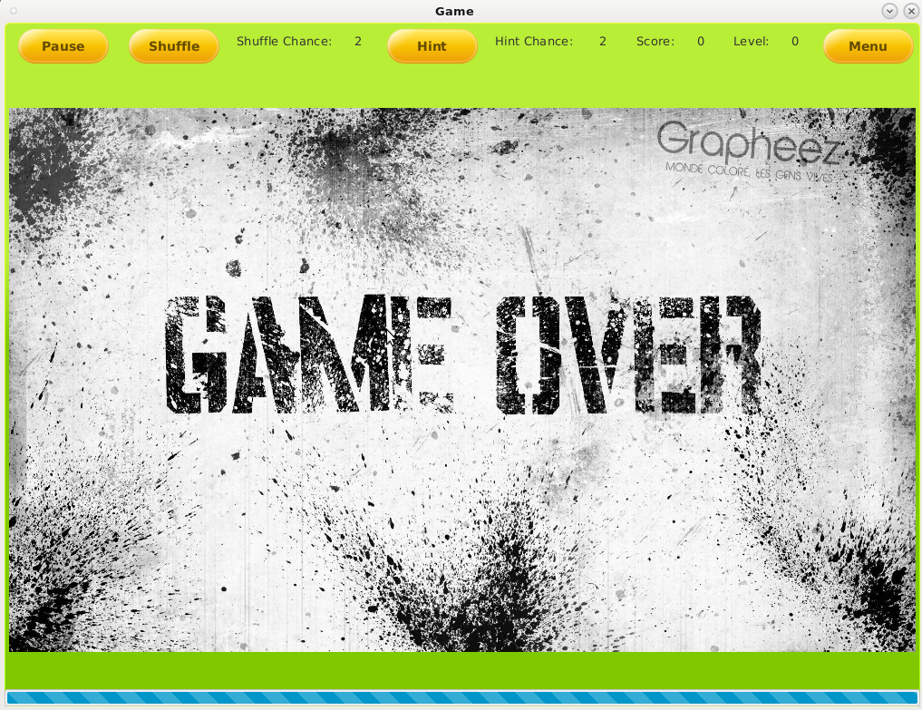
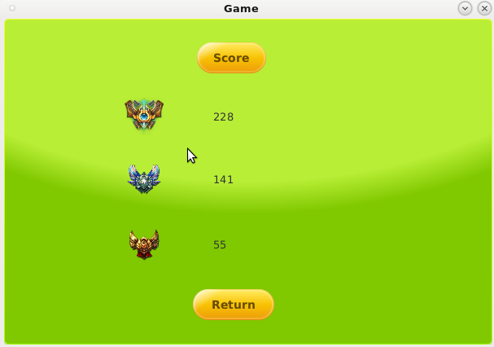
User Interface

Slide 12
Challenges
Concurrency ---- Thread control
Tile
Music

Slide 13
What we learned?
Team work
Specific techniques
Audio manipulation
Thread
CSS
Switch scenes

Slide 14
Potential Improvements in Version 2.0
Interactive tutorial
Internet for multiplayers
Lines

Slide 15
Game Demo!

